Slide 1
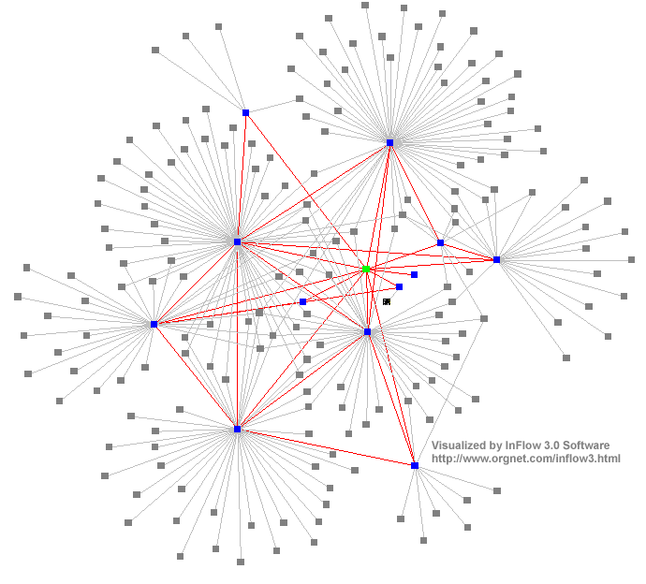
Distributed Computing Systems
Networking and Interworking in DS
Dr. Sunny Jeong spjeong@uic.edu.hk
Mr. Bill Junru ZHONG billjrzhong@uic.edu.hk
With Thanks to Prof. G. Coulouris,
Prof. A.S. Tanenbaum and Prof. S.C Joo

Slide 2
Overview
Networks used in DS
  transmission medias
    hardware devices
    software components
Types of networks: how to choose
  Range, bandwidth, latency
Networking principles: how it works conceptually
  transfer mode, switching schemes
  protocol suites, routing, congestion control
Sample protocols: how it works in detail
  MobileIP, TCP/UDP, Wireless LAN

Slide 3
Network issues in DSs
Performance
  Latency
  Data transfer rate
    Message transfer rate time = latency + a massage length/ data transfer rate
  Total system bandwidth of network
    Throughput in the end systems
    total volume of traffic can be transferred across network in a time
Scalability
  No designable to cope with size and load about network growing
Reliability
  recoverable from communication failures

Slide 4
Network issues in DSs ctd
Security
  protecting network and computers,
    ex) firewall between intranet and internet, Intrusion Detective System(IDS) …etc
Mobility
  portability of computer and handled digital devices using wireless network
  location and identification are depicted with each other
  no designable to cope with size and load about network growing
QoS(Quality of Service)
  guarantee for requirements of computer and network
    to meet deadline, bandwidth, bounded latency
Multicasting
  One-to-many communication

Slide 5
Types of Networks
LANs (Local Area Networks)
  technology suitable for small area, wire/fiber
WANs (Wide Area Networks)
  large distances, inter-city/country/continental
MANs (Metropolitan Area Networks)
  intra-city, cable based, multimedia
Wireless networks
  WLANs, WPANs(wireless personal area network)
=> Distinguished by technology, not only distances.

Slide 6
LANs
High bandwidth
(total amount of data per unit of time)
Low latency
(time taken for the first bit to reach destination)
Technology
  predominantly Ethernet, now 100/1000Mbps(= Gigabps)
  earlier token ring
  ATM better QoS, but more expensive

Slide 7
LAN example: SoCS
Campus
138.37.95.240/29
138.37.95.241
router/
router
subnet
firewall
hammer
Staff subnet
Student subnet
138.37.88
138.37.88.251
138.37.94.251
138.37.94
compute
Eswitch
Eswitch
file server/
server
gateway
bruno
138.37.88.249
custard
printers
dialup
138.37.94.246

server
henry
138.37.88.230
other
file
servers
server
hotpoint
138.37.88.162
web
server
copper
138.37.88.248
hub
hub
desktop computers
138.37.88.xx
desktop computers
138.37.94.xx
Campus
138.37.95.248/29
sickle
100 Mbps Ethernet
router
subnet
138.37.95.249
router/
firewall
1000 Mbps Ethernet
Eswitch: Ethernet switch

Slide 8
WANs
P(personal)ANs →WPANs in WLAN
Low bandwidth, high latency
Satellite/wire/cable
Routers introduce delays
MANs
Wire/cable
Range of technologies (ATM, Ethernet)

Slide 9
Wireless networks
WLANs (Wireless Local Area Networks)
  to replace wired LANs
  WaveLAN technology (WIFI(Wireless Internet Platform for Interoperability) : IEEE 802.11)
* Note : WMAN : WiMAX(IEEE 802.16), called Wibro in KOREA ^^
WPANs (Wireless Personal Area Networks)
  variety of technologies
  infra-red links
    BlueTooth(:IEEE 802.15.1) low-power radio, palmtop, laptop computer
  Mobile phone network(Wireless WAN)
    European GSM(Global system for Mobile communication)
    US: analogue AMPS cellular radio network, Cellular Digital Packet Data
  WAP (Wireless Applications Protocol)
    for use on wireless potable devices

Slide 10
WAP Programming Model
WAP ?
  Protocol for presentation and delivery of wireless information and telephony services on mobile phones and other wireless terminals
Programming Model
Client
Gateway
Origin Server
WAE user agent
Encoders and decoders
Enc. Request
Requests
CGI scripts
Enc. Response
Response
Content

Slide 11
WAP protocol stack
Application Layer:
  Wireless Application Environment (WAE) – binary HTTP, WML, WMLscript
Session Layer:
  Wireless session protocol (WSP – lightweight suspend)
Transaction Layer:
  Wiress transaction protocol (WTP – optimized TCP)
Security Layer:
  Wireless Transport Layer Security (WTLS – optim. SSL)
Transport Layer:
  UDP/IP or WDP(Wireless Datagram Protocol)
Network layer:
  SMS, USSD, CSD, IS-126, CDMA, IDEN, CDPD etc..

Slide 12
Network comparisons
Types | Range(?) | Bandwidth (Mbps) | Latency (ms)
LAN(Ethernet) MAN(ATM) | 1-2 kms 2-50km | 10-1000 1-150 | 1-10 10
WAN(IP routing) | Worldwide | 0.010-600 | 100-500
Internetwork (Internet) | Worldwide | 0.5-600 | 100-500
Wireless PAN Bluetooth(IEEE802.15.1) Wireless LAN WiFi(IEEE 802.11) | 10-30m 0.15-1.5 km | 0.5-2 2-11 | 5-20 5-20
Wireless WAN WiMAX(IEEE 802.16) | 5-50km | 1.5-20 | 5-20
WWAN (GSM, 3G phone) | worldwide | 0.010-2 | 100-500
4G LTE | worldwide | 300(20) | 50
5G | worldwide | 1G< | 1

Slide 13
Network principles
Mode of transmission
Switching schemes
Protocol suites
Routing
Congestion control

Slide 14
Mode of transmission
Packets
  messages divided into packets( on Transport Layer)
  packets queued in buffers before sent onto link
  QoS not guaranteed
Data streaming
  links guarantee QoS (rate of delivery)
  for multimedia traffic
  need higher bandwidth

Slide 15
Switching schemes
Broadcasts (Ethernet, wireless)
  send messages to all nodes
  nodes listen for own messages (carrier sensing)
Circuit switching (phone networks)
Packet switching (TCP/IP)
  store-and-forward
  unpredictable delays
Frame/cell relay (ATM)
  bandwidth & latency guaranteed (virtual path)
  small, fixed size packets (padded if necessary)
    53bytes= header 5 + body 48
  avoids error checking at nodes (use reliable links)

Slide 16
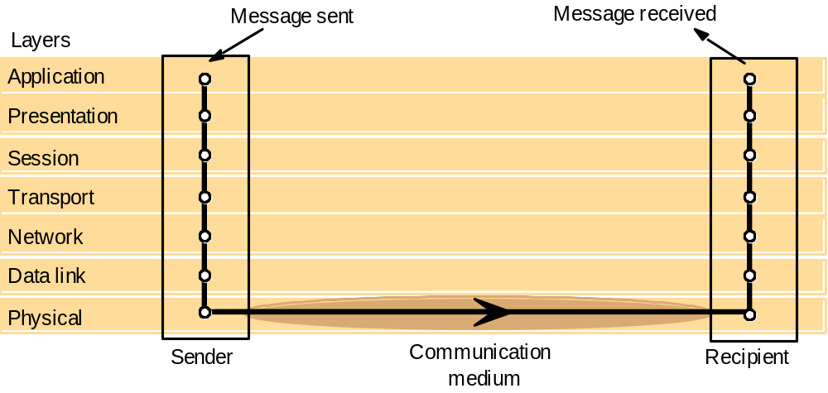
Protocols ( ISO Open System Interconnection view)
Definition
  set of rules and formats for exchanging data, arranged into layers called protocol suite or stack.

Slide 17
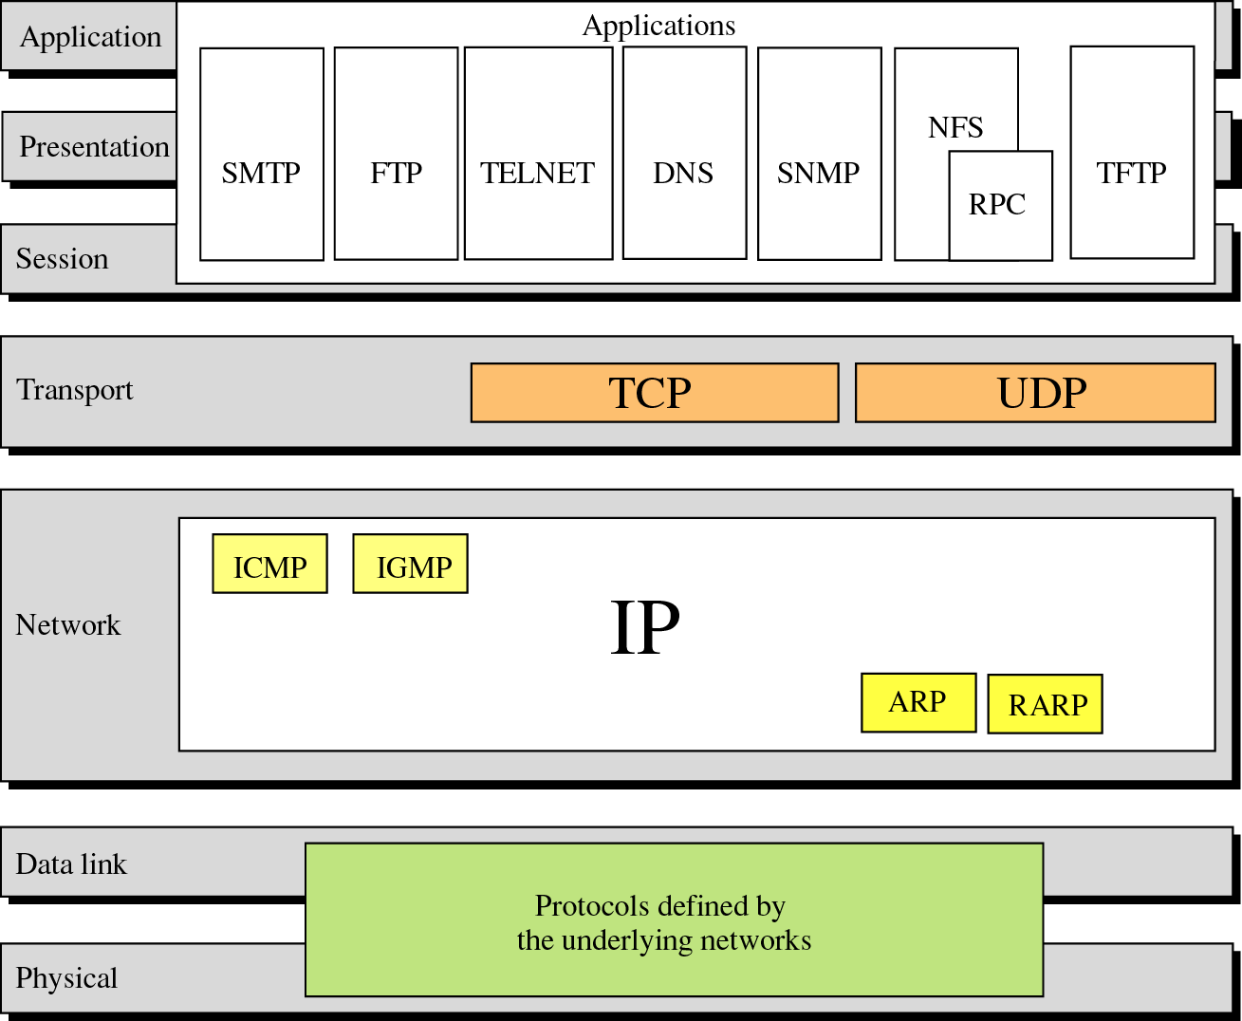
OSI model
(Trivial File Transfer Protocol)
Internet Control(Group) Message Protocol
(Reverse Address Resolution Protocol)

Slide 18
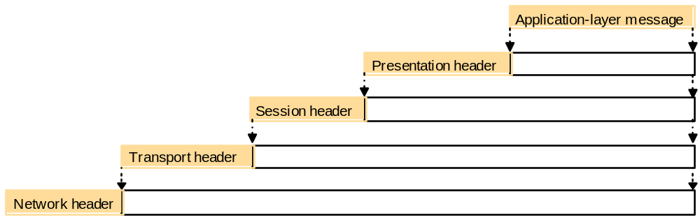
Message encapsulation
Headers appended/unpacked by each layer.
HTTP, FTP, e-mail,
External data representation, encryption
Failure detection and recovery
TCP,UDP
IP, ATM

Slide 19
OSI protocol summary
Layer
Description
Examples
Application
Protocols that are designed to meet the communication requirements of
HTTP,
FTP
,
SMTP,
specific applications, often defining the interface to a service.
CORBA IIOP
Presentation
Protocols at this level transmit data in a network representation that is
Secure Sockets
independent of the representations used in individual computers, which may
(
SSL),CORBA Data
differ. Encryption is also performed in this layer, if required.
Rep.
Session
At this level reliability and adaptation are performed, such as detection of
failures and automatic recovery.
Transport
This is the lowest level at which messages (rather than packets) are handled.
TCP,
UDP
Messages are addressed to communication ports attached to processes,
Protocols in this layer may be connection-oriented, or connectionless.
Network
Transfers data packets between computers in a specific network. In a WAN
IP,
ATM virtual
or an internetwork this involves the generation of a route passing through
circuits
routers. In a single LAN, no routing is required.
Data link
Responsible for transmission of packets between nodes that are directly
Ethernet MAC,
connected by a physical link. In a WAN transmission is between pairs of
ATM cell transfer,
routers or between routers and hosts. In a LAN it is between any pair of hosts.
PPP
Physical
The circuits and hardware that drive the network. It transmits sequences of
Ethernet base- band
binary data by analogue signalling, using amplitude or frequency modulation
signalling,
ISDN
of electrical signals (on cable circuits), light signals (on fibre optic circuits)
or other electromagnetic signals (on radio and microwave circuits).

Slide 20
Internetwork protocol
Intenetwork layer(=Virtual network layer)
  internet packet → destination (by datagram protocol)
Network interfaces layer
  Internetwork packets → suitable packets → underlying layer
Underlying network layer
Message
Layers
Application
Internetwork
Transport
protocols
Internetwork
Internetwork packets
Network interface
Underlying
Network-specific packets
network
protocols
Underlying network

Slide 21
Port & Addressing
Port
  network-independent message transport service between networks ports
  software-definable destination points for communications
  in chapter 4.
Addressing
  delivering messages to destination with transport addresses
  Transport address
    Network address + port number

Slide 22
Packet delivery
In network layer
  datagram packet delivery(IP in Ethernet, most wired and wireless LAN technologies)
  virtual circuit packet delivery(ATM)
In transport layer
  connection-oriented transmission(TCP)
    Reliable communication with static routing table(ISO, X.25)
    Ex) remote login(Telnet), FTP, HTTP(big-sized file), stream data
  connectionless transmission(UDP)
    Unreliable communication with pre-defined routing table
    Ex) rcp, rwho, RPC, HTTP(small-sized file), FTP(non-error bulk file)

Slide 23
Routing
Necessary in non-broadcast networks (cf Internet) : Hop by Hop
Distance-vector algorithm for each node
  stores table of state & cost information of links, cost infinity for faulty links
  determines route taken by packet (the next hop)
  periodically updates the table and sends to neighbors
  may converge slowly [Bellman-Ford]
RIP-1(Router Information Protocol) for Internet
  Local router table changes
  use default routes, plus multicast and authentication
  better convergence( routes better route to an existing destination)

Slide 24
Routing example
A
1
B
Hosts
2
3
Links
4
or local
C
networks
5
D
6
E
Routers

Slide 25
RIP routing algorithm
A
1
B
Hosts
Links
2
or local
3
4
C
networks
5
D
6
E
Routers
Variables: Tl local table, Tr remote table received.
Send: Each t seconds or when Tl changes, send Tl on each non-faulty outgoing link.
Receive: Whenever a routing table Tr is received on link n:
for all rows Rr in Tr {
if (Rr.link != n) {
Rr.cost = Rr.cost + 1; // hop
Rr.link = n;
if (Rr.destination is not in Tl) add Rr to Tl;
// add new destination to Tl
else for all rows Rl in Tl {
if (Rr.destination = Rl.destination and
(Rr.cost < Rl.cost or Rl.link = n)) Rl = Rr;
// Rr.cost < Rl.cost : remote node has better route
// Rl.link = n : remote node is more authoritative
}
}
}
A-routing->C
init R.l.cost = 0
A->B->C, Rr.cost=2
A->D->E->C, Rr.cost=3
A->D->E->B->C, Rr.cost=4
Tl.Rl.cost = 2
* Rr: remote, Rl : local

Slide 26
Routing tables(A->C)
A
1
B
2
Hosts
Links
or local
3
4
C
networks
D
6
E
5
Routers
Routings from A
Routings from B
Routings from C
To
Link
Cost
To
Link
Cost
To
Link
Cost
A
local
0
A
1
1
A
2
2
B
1
1
B
local
0
B
2
1
C
1
2(2)
C
2
1(1)
C
local
0
D
3
1
D
1
2
D
5
2
E
1
2
E
4
1
E
5
1
B(select)
A
C
Rr.cost(=1) < Rl.cost(=2)
D
Routings from D
Routings from E
To
Link
Cost
To
Link
Cost
A
3
1
A
4
2
Rr.cost(=2) >= Rl.cost(=2)
B
3
2
B
4
1
C
6
2
C
5
1
D
local
0
D
6
1
E
6
1
E
local
0

Slide 27
Sample routes(C->A)
Send from C to A:
  to link 2, arrive at B
  to link 1, arrive at A
Send from C to A if B table modified ~
  to link 5, arrive at E
  to link 4, arrive at B
  to link 1, arrive at A
Routings from C
A
1
B
Routings from C
2
Hosts
Links
To
Link
Cost
To
Link
Cost
or local
3
4
C
A
2
2
networks
5
B
2
1
B
2
1
D
6
E
C
local
0
C
local
0
Routers
D
5
2
E
5
1
E
5
1
default
5
-

Slide 28
Congestion control
When load on network exceeds 80% of its capacity
  packet queues long, links blocked
Solutions(in datagram-based network layers)
  packet dropping
    reliable of delivery at higher levels
  reduce rate of transmission
    nodes send choke packets (Ethernet)
      special message requesting a reduction in transmission rate
    transmission control (TCP)
  transmit congestion information to each node
    QoS guarantees (ATM)

Slide 29
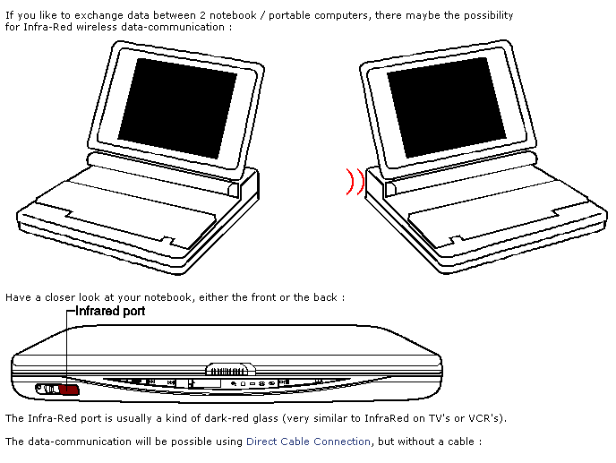
Protocol examples
MobileIP
  connectivity for mobile devices, even in transit
  device retains single IP address
  re-routing by Home Agents (HA) and Foreign Agents (FA)
  transparent
TCP and UDP
  main transport level protocols used by IP
Wireless LAN (IEEE 802.11)
  radio or infra-red communications
  CSMA/CA based
    Carrier Sensing Multiple Access/Collision Avoidance

Slide 30
Transport level protocols
UDP (basic, used for some IP functions)
  uses IP address+port number
  no guarantee of delivery, optional checksum
  messages up to 64KB
  Connectionless transmission( → Unreliable and Asynchrnous communication with pre-defined routing table)
  Datagram service
  Ex) rcp, rwho, RPC, HTTP(small sized), FTP(non-error bulk file)
TCP (more sophisticated, most IP functions)
  data stream abstraction, reliable delivery of all data
  messages divided into segments, sequence numbers
  sliding window, acknowledgement+retransmission
  buffering (with timeout for interactive applications)
  checksum (if no match segment dropped)
  Connection-oriented transmission( → Reliable and Synchronous communication with static routing table(ISO, X.25))
  Stream service
  Ex) remote login(Telnet), FTP, HTTP(bulk file), stream data

Slide 31
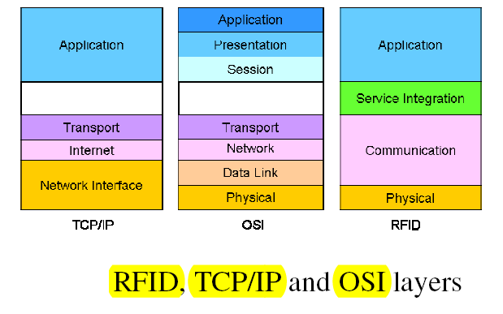
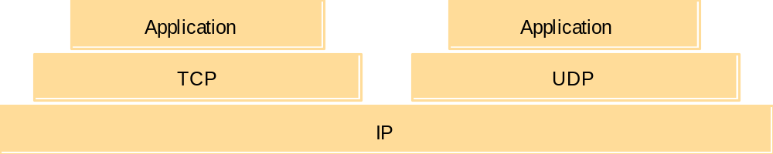
Transport level protocols ctd
Message
Layers
Application
Messages (UDP) or Streams (TCP)
Transport
UDP or TCP packets
Internet
IP datagrams
Network interface
Network-specific frames
Underlying network

Slide 32
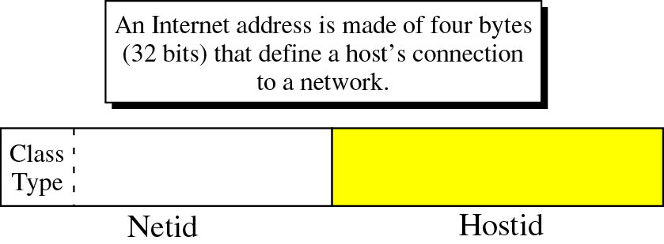
IP(TCP/IP) Addressing
IP Address(IPv4)

Slide 33
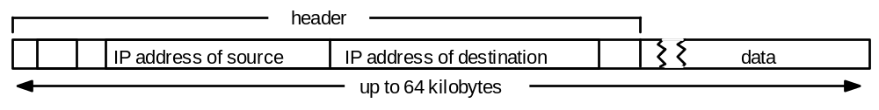
IP(TCP/IP) Addressing ctd
IP Structure(Universal)(IPv4 : 4bytes: 32bits)
7
24
Class A:
0
Network ID
Host ID
14
16
Class B:
1
0
Network ID
Host ID
21
8
Class C:
1
1
0
Network ID
Host ID
28
Class D (multicast):
1
1
1
0
Multicast address
27
Class E (reserved):
1
1
1
1
0
unused
IP Packet layout

Slide 34
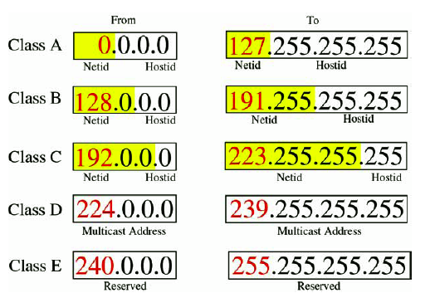
IP(TCP/IP) Addressing ctd
octet 1
octet 2
octet 3
octet 4
Range of addresses
Network ID
Host ID
Class A:
1 to 127
0 to 255
0 to 255
0 to 255
1.0.0.0 to
127.255.255.255
Network ID
Host ID
Class B:
128 to 191
0 to 255
0 to 255
0 to 255
128.0.0.0 to
191.255.255.255
Network ID
Host ID
Class C:
192 to 223
0 to 255
0 to 255
1 to 254
192.0.0.0 to
223.255.255.255
Multicast address
Multicast address
Class D (multicast):
224 to 239
0 to 255
0 to 255
1 to 254
224.0.0.0 to
239.255.255.255
Class E (reserved):
240 to 255
0 to 255
0 to 255
1 to 254
128.0.0.0 to
247.255.255.255
Address 194.0.0.0 to 195.255.255.255.are in Europe
Address 198.0.0.0 to 199.255.255.255.are in N. America
Address 200.0.0.0 to 201.255.255.255.are in Central & South America
Address 202.0.0.0 to 195.203.255.255.are in Asia and Pacific

Slide 35
IPv4-> IPv6
IPv6 Address
  Large Address space - 128 bit addresses
    Every toaster can have its own IP address
  Aggregation-based address hierarchy
    Efficient backbone routing
  Efficient and Extensible IP datagram
    No fragmentation by routers
    64 bits field alignment
    Simpler basic header
  Auto-configuration
  Security
  IP Renumbering part of the protocol

Slide 36
IPv4-> IPv6
3FFE:0B00:0C18:0001:0290:27FF:FE17:FC0F
16 bits 32 bits 16 bits 64 bits
  TLA – top level aggregator
    Primary providers
  NLA: Next Level Aggregator
    Can have multiple NLA as sub-NLA
  SLA: Site Level Aggregator
    Your site (16 bits)
  Addresses are allocated from your provider
    If you change provider, your prefix changes
    But renumbering (of hosts, routers and sites) has been included in the IPv6 protocol
TLA
NLA(s)
SLA
Interface ID

Slide 37
IPv4-> IPv6
IPv6 Header layout(16bytes : 128bits)
IPv6’s main advances(Adapted by IETF in 1994)
  address space(2128 = 3×1038 IPs), routing speed up
  Real-time and other special services
  Future evolution
  Multicating & anycasting
  security
Version (4 bits)
Traffic class (8 bits)
Flow label (20 bits)
Payload length (16 bits)
Next header (8 bits)
Hop limit (8 bits)
Source address
(128 bits)
Destination address
(128 bits)

Slide 38
MobileIP
At home normal, when elsewhere mobile host:
  notifies HA(Home Agent) before leaving
  informs FA(Foreign Agent), who allocates temporary care-of IP address & tells HA
Packets for mobile host(MH):
  first packet routed to HA, encapsulated in MobileIP packet and sent to FA (tunnelling)
  FA unpacks MobileIP packet and sends to mobile host
  sender notified of the care-of address for future communications which can be direct via FA
Problems
  efficiency low, need to notify HA

Slide 39
MobileIP routing
Sender
4.Subsequent IP packets
tunnelled to FA
Mobile host (MH)
3.Address of FA
returned to sender
1.First IP packet
addressed to MH
Internet
Foreign agent(FA)
Home
2.First IP packet
Agent
HA
tunnelled to FA

Slide 40
Wireless LAN (IEEE 802.11)
Radio broadcast (fading strength, obstruction)
Collision avoidance by
  slot reservation mechanism by Request to Send (RTS) and Clear to Send (CTS)
  stations in range pick up RTS/CTS and avoid transmission at the reserved times
  collisions less likely than Ethernet, since RTS/CTS short
  random back off period
Problems
  security (eaves dropping), use shared-key authentication

Slide 41
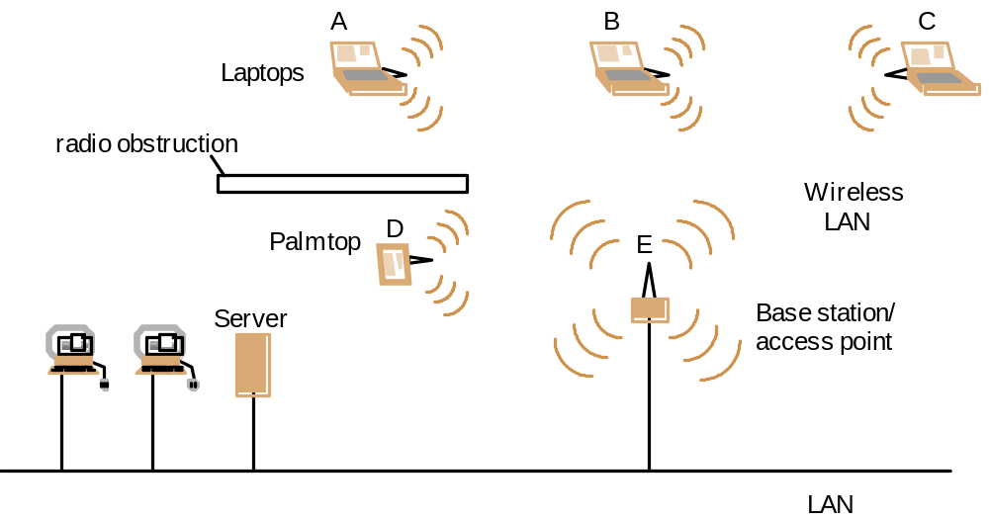
Wireless LAN configuration

Slide 42
Asynchronous Transfer Mode(ATM)
Asynchronous Transfer Mode(ATM)
  Multimedia data(voice and video), distributed system services are available
  Packet switching network based on Cell-relay(a method of packet routing)
  Avoiding flow-control and error checking at the intermediate nodes
  Small and fixed length unit of data transmitted(53bytes= header 5 + body 48)
    reduction of buffer size, complexity, queuing delay at intermediate nodes
  B-ISDN(CCITT I.150 standard)
  Optical fiber transmission medium(155 - 622 megabits/sec)
  ATM protocol layers(next page)

Slide 43
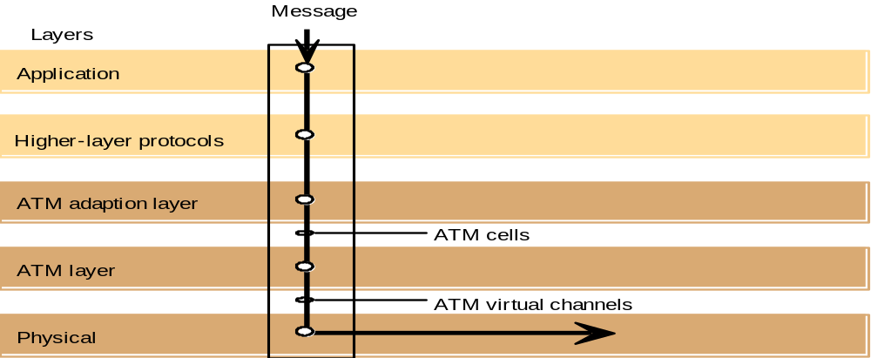
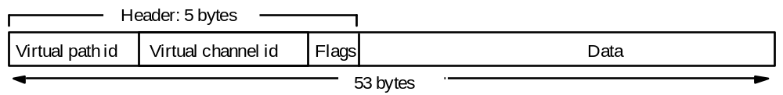
Asynchronous Transfer Mode(ATM)- ctd
ATM protocol Layer
ATM cell layout

Slide 44
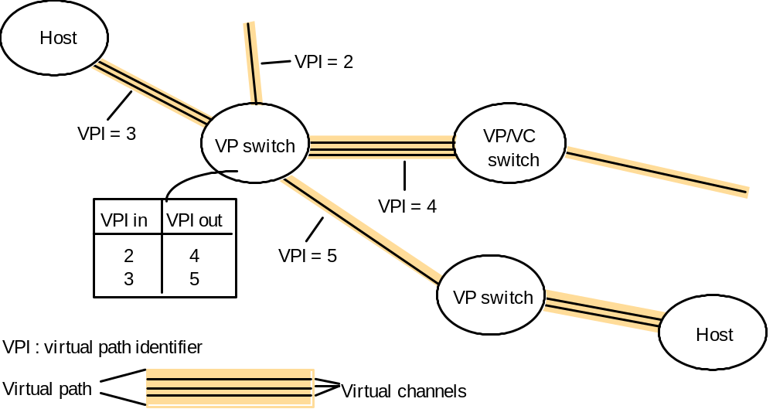
Asynchronous Transfer Mode(ATM) -ctd
Switching virtual in an ATM network

Slide 45
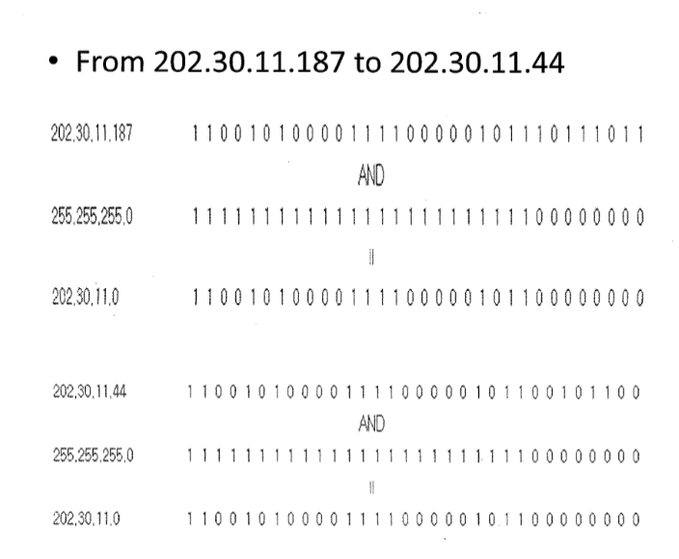
How determine needs of router

Slide 46
Summary
LANs
  provide data transmission via layered protocol suites
  delivery not always reliable (packet dropping)
  congestion control needed to ensure QoS
  Security- an issue for wireless (eaves dropping)
WANs/Internet
  require routers and routing mechanism
  extra complexities in mobile context

